Slide 1

Epilepsy Surgery Trends in the United States from 1990 to 2008
David Ouyang

Slide 2
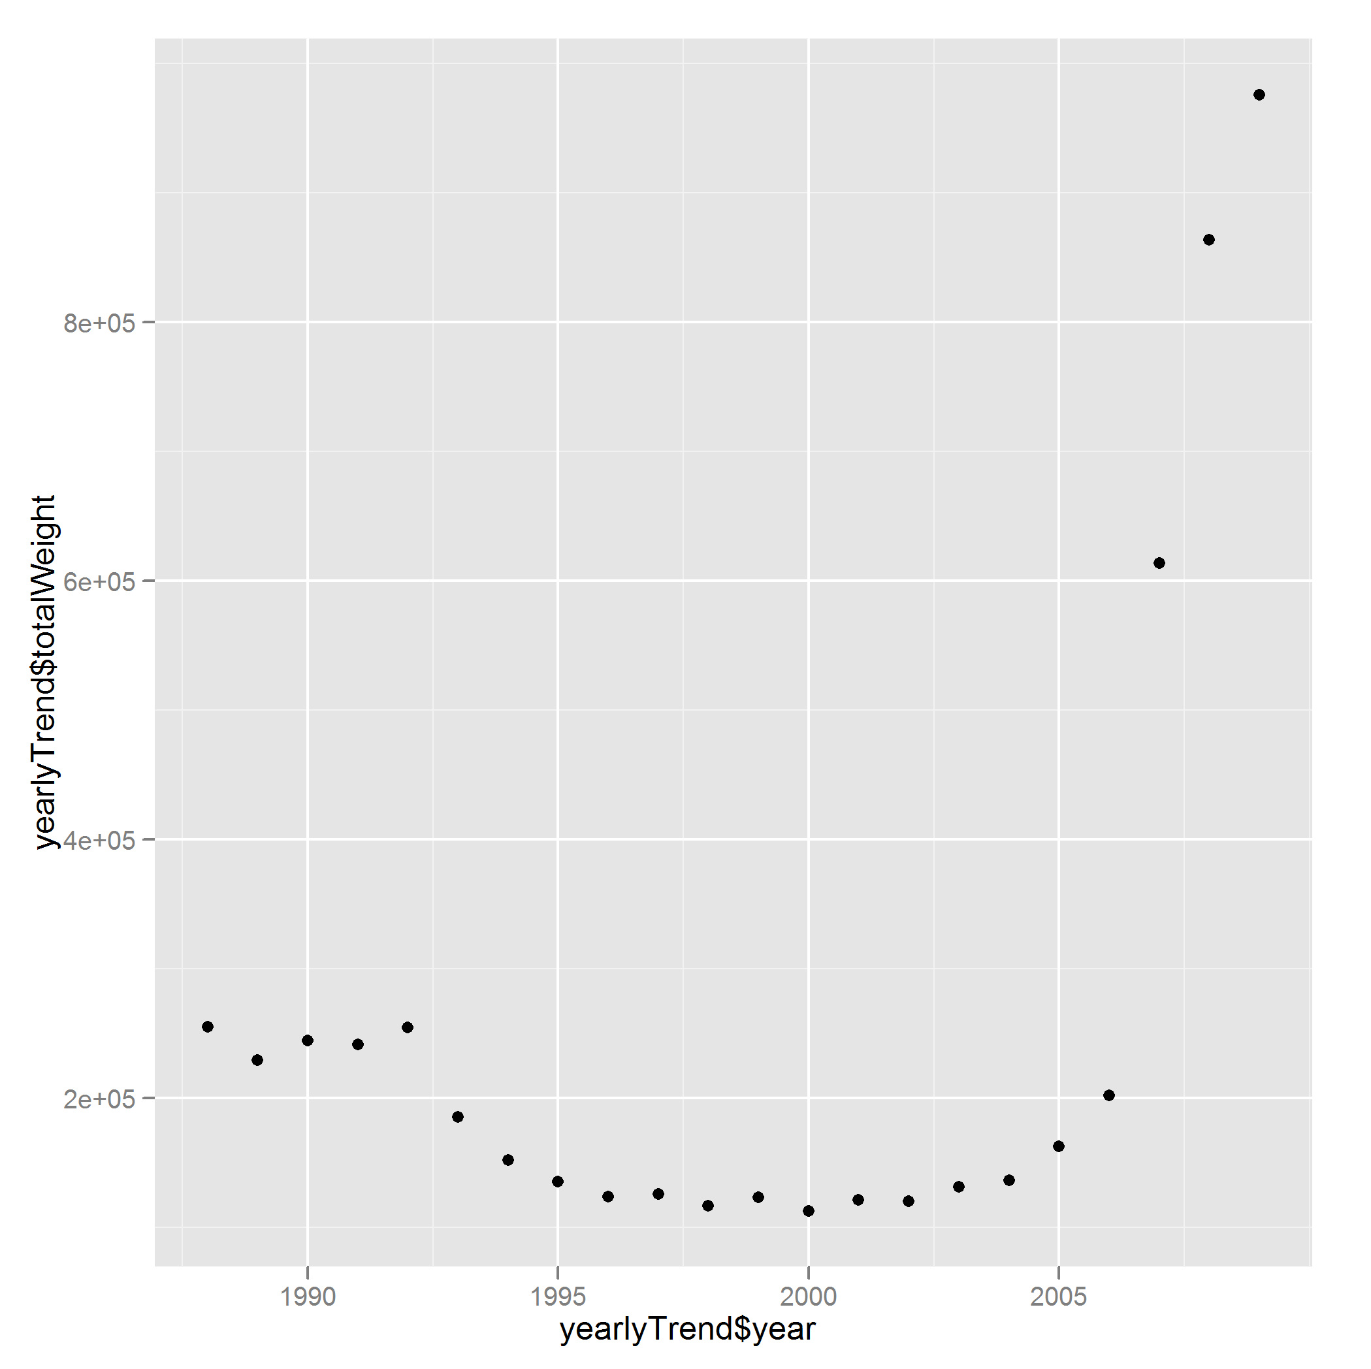
Medically refractory epilepsy is a common, highly morbid disease
Introduction
epilepsy affects between 5 – 10 per 1000 and accounts for 1% of the global burden of disease based on disability-adjusted life-years (DALYs)
pharmacotherapy is unsuccessful in controlling seizures in 20% to 40% of patients.

Slide 3
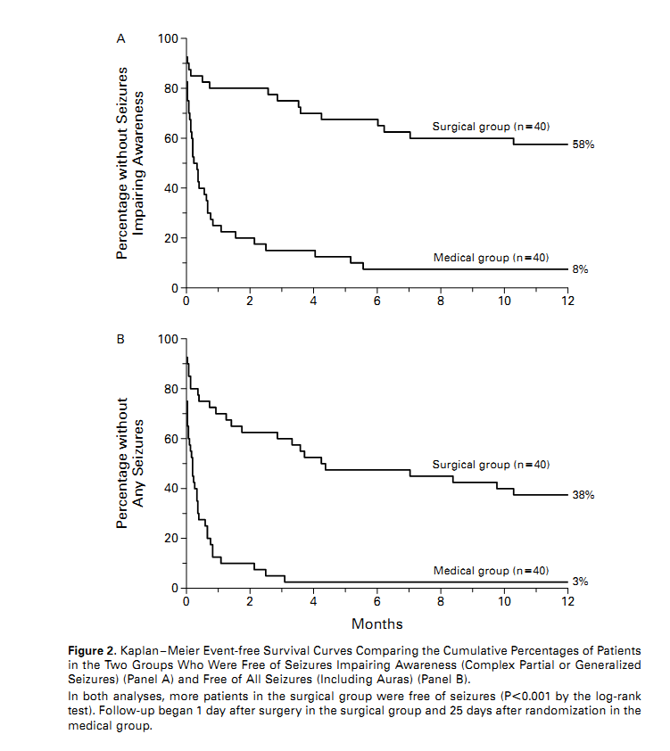
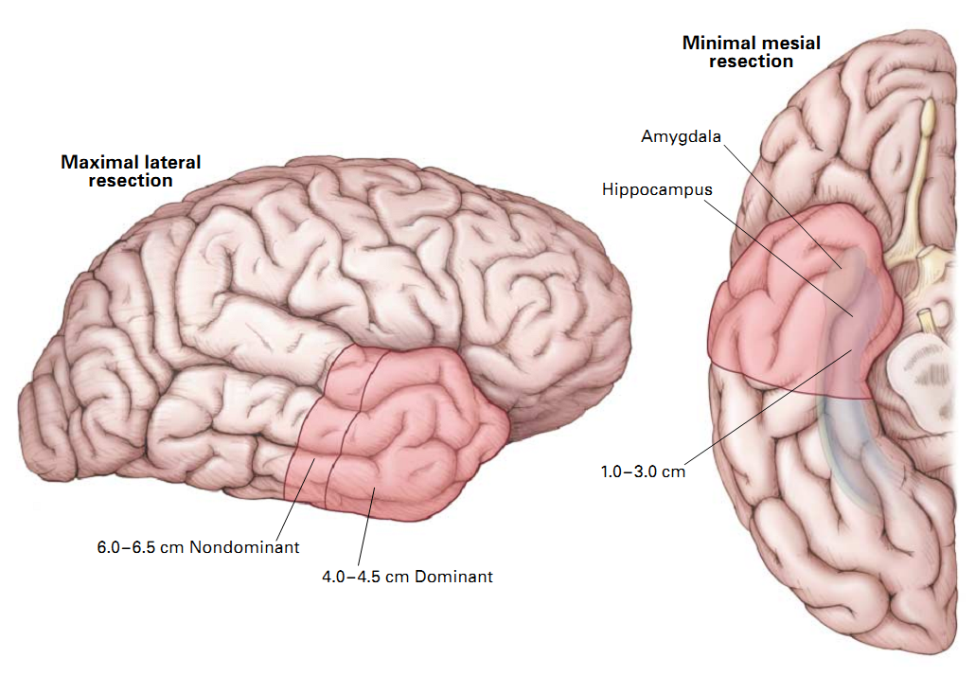
Anterior temporal lobectomy has been validated as a treatment for temporal lobe epilepsy
Background
In 1993, it was estimated 1,500 out of 100,000 eligible surgical candidates received surgery for temporal lobe epilepsy.

Slide 4
Has the use of lobectomy for patients with intractable epilepsy expanded in light of class I clinical evidence demonstrating efficacy?
Research Question

Slide 5
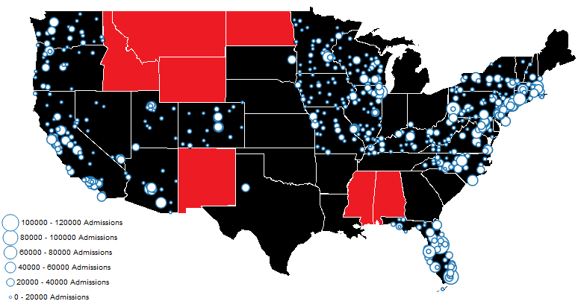
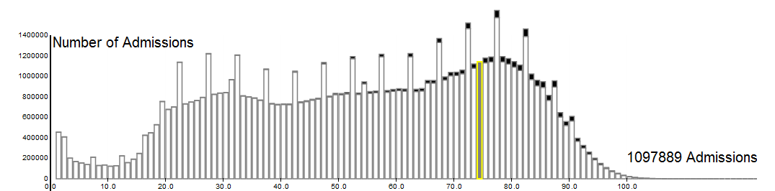
The Nationwide Inpatient Survey is a stratified sample of inpatient admissions of US hospitals
Methods

Slide 6
Structure of the Data
1988 - 1992
1993- 1997
1998- 2008
2009
Age, Death, Disposition, <15 diagnoses (comorbidities), <15 procedures (days from event), length of stay, Gender, Race, Payer,
Yes/No list of Common Comorbidities
Hospital Characteristics
Core Patient File
Severity File
Procedure and Condition Groups
Hospital Name, Address, Bed Size, Teaching Status, Rural/urban, total number of discharges, RN FTEs

Slide 7
Study
Design
medically-refractory localized epilepsy (n = 22,133)
Temporal lobectomy (n = 1,326)
No temporal lobectomy (n = 20,807)
863
10,932
1990 - 2001
P < 0.001
463
9,875
2002 - 2008

Slide 8
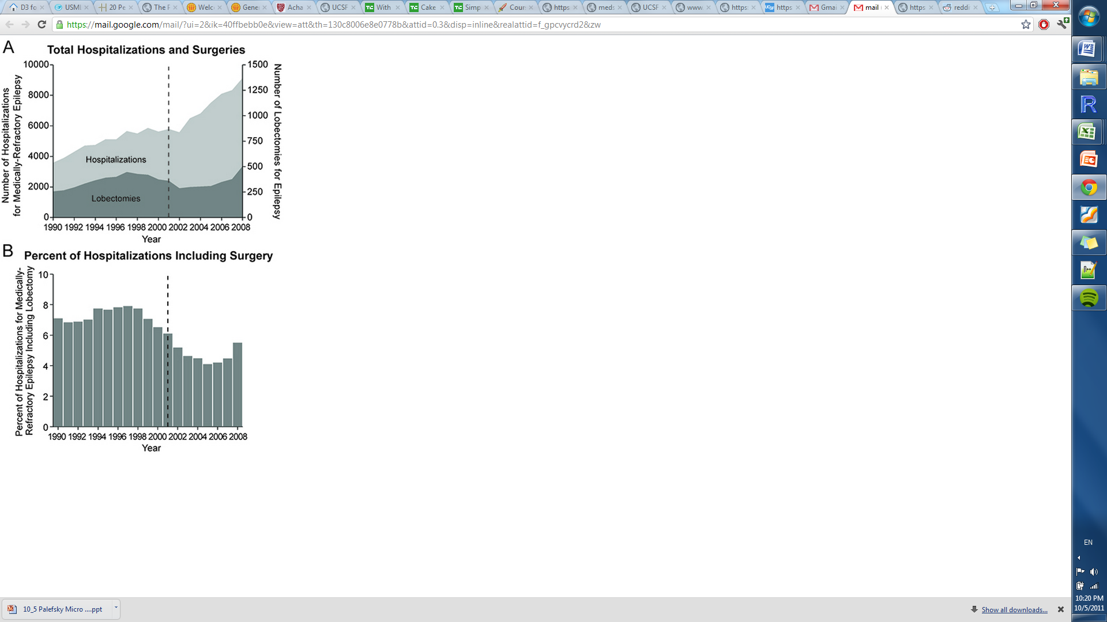
The use of lobectomy for medically intractable epilepsy has not increased between 1990 – 2008.
Results

Slide 9
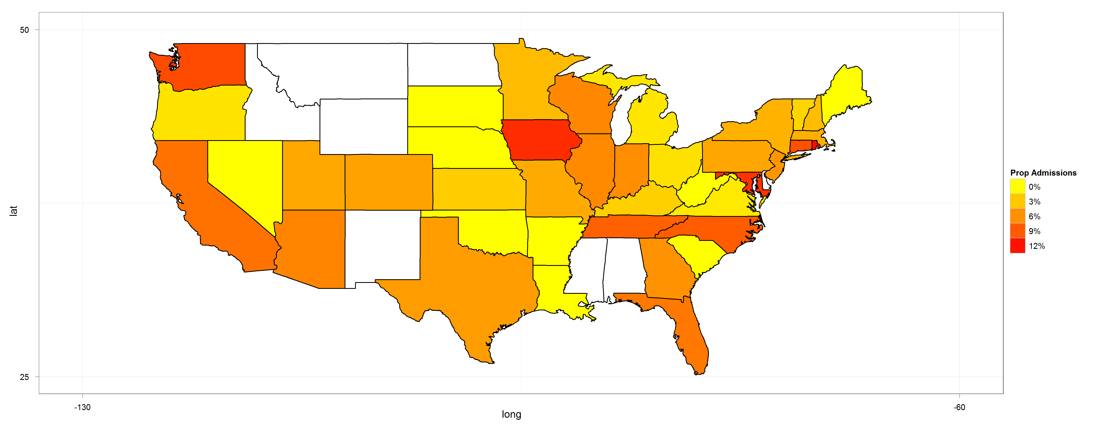
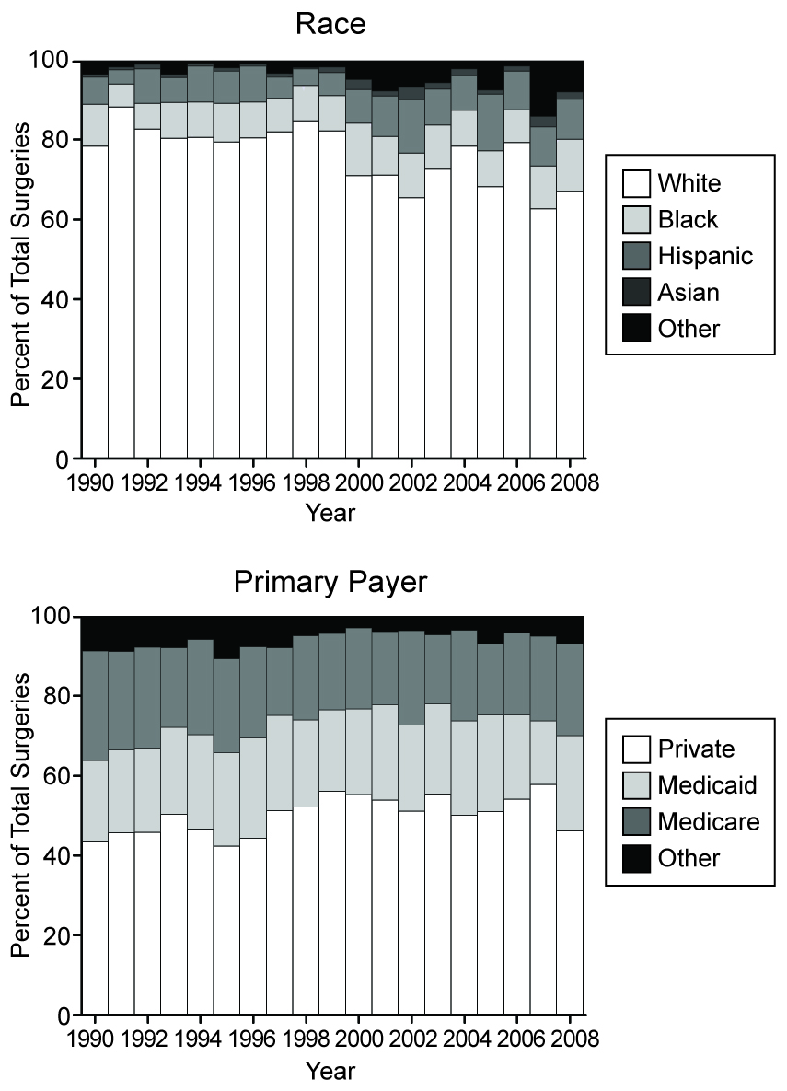

There exists regional, payer, race, and hospital status based disparity in the utilization of lobectomy

Slide 10

There exists statistically significant differences in likelihood of receiving lobectomy and risk of adverse events based on hospital volume
(MAKE A GRAPH)
However, we found that the rate of lobectomy at the 20 highest-volume epilepsy centers remained constant over the study period.
decreased admissions of uncontrolled focal epilepsy patients to high-volume epilepsy centers
increased admissions to low-volume hospitals that were considerably less likely to perform the procedure.
X² = 13.6, p = 0.0002

Slide 11
Conclusions
Lobectomy for medically intractable epilepsy is still underutilized, particularly among racial minorities and the underinsured.
Patients with medically-refractory epilepsy should be referred to a comprehensive epilepsy center for surgical evaluation by an experienced epilepsy treatment team.

Slide 12
Acknowledgements
Eddie Chang MD
Paul Garcia MD
Dario Englot MD PhD
Doris Wang MD PhD
John Rolston MD PhD

